Slide 1
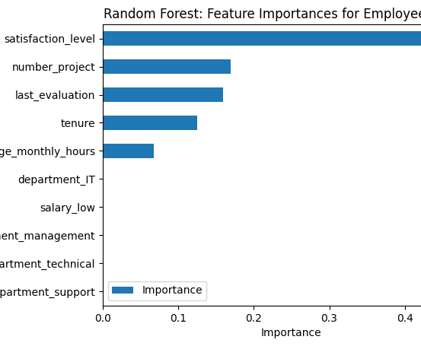
Salifort Motor
Employee Churn Prediction
Project Overview
To predict whether an employee will leave the company using statistical model like logistic regression or machine learning models such Logistic Regression and Random Forest.
Key Findings
Employee satisfaction is the strongest predictor of turnover.
Work-related factors (tenure, project load, hours) significantly impact retention.
Department and salary level have moderate influence on turnover.
Performance evaluations correlate with turnover decisions.
Business Recommendations
Immediate Actions
Implement regular satisfaction surveys and feedback sessions.
Review workload distribution for employees with multiple projects,
Develop clear career progression paths based on tenure milestones.
Policy Changes
Establish workload limits (number of concurrent projects).
Create structured promotion and salary review cycles.
Implement work-life balance initiatives to manage monthly hours.
Deploy Random Forest model for ongoing turnover risk assessment.
Set up regular model performance monitoring.
Collect additional data on:
Employee feedback.
Project complexity.
Team dynamics.
Work-life balance metrics.

